Slide 1
Reading Circle @ unit 5

Slide 2
Highlighter
Visualizer
Connector
Questioner

Slide 3
第七周
确定分组名单
学生选取角色，准备材料参与讨论
第九周
学生组内分享 (Each member to present their prepared role information for 8 to 10 minutes）
完成组内互评（5 minutes）
第十周
每组最佳做班级展示 （The best role of each group to present for 9 to 10 minutes）
教师评分 （点评）
第十一
周
教师综合反馈
总结、查缺补漏 （20 minutes）

Slide 4
@Highlighter
Word Master; Word Wizard…

Slide 5

Highlighter
Your task is to:
Pick out information on any new or important expressions. Think about the following:
Which 10 words/phrases are most useful for readers to learn? To be selective.
What effect does the language have on the reader? Why do they stand out?
Design 10 questions for your partners to do in order to make the information more memorable and try to be creative.

Slide 6
@Visualizers
Summarizer, Illustrator…

Slide 7

Visualizers
Your task is to:
Represent the text in a visual way.
You could do this by creating your own picture, diagram, mind- map and video; designing a storyboard; producing a graph to show different pieces of information; or finding an image from the internet – it is your choice!
Don’t worry if you are not artistic – this exercise is to show how information can sometimes be easier to understand without using many words.

Slide 8
@Questioners
Discussion leader，Passage person…

Slide 9

Questioner
Your task is to:
Make a list of 7 questions about the text. They could be:
Which 3 sentences in the text are most useful for readers to learn? To be selective.
2 general questions about the text to provoke thinking
2 inspiring questions to be asked.
Usually the best questions come from your own thoughts, feelings and questions as you read. It’s advisable to have your reference answers ready.

Slide 10
@Connectors
Culture Collector…

Slide 11

Connector
Your task is to:
Pick out information which connects to your life experience, your studies or the world outside. Things to think about are:
How does this new information connect to what you already know?
Has anything similar ever happened to you or your friend?
How could you use this information in your life?
Are there any surprising connections between this topic and other texts you have read?
Try to be creative, and think of as many options as possible.

Slide 12
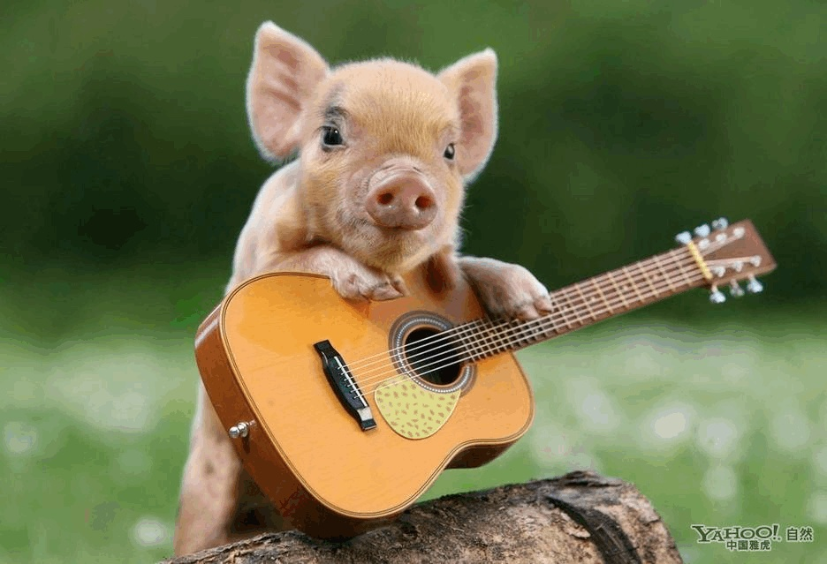
Thank you for listening!

